Slide 1
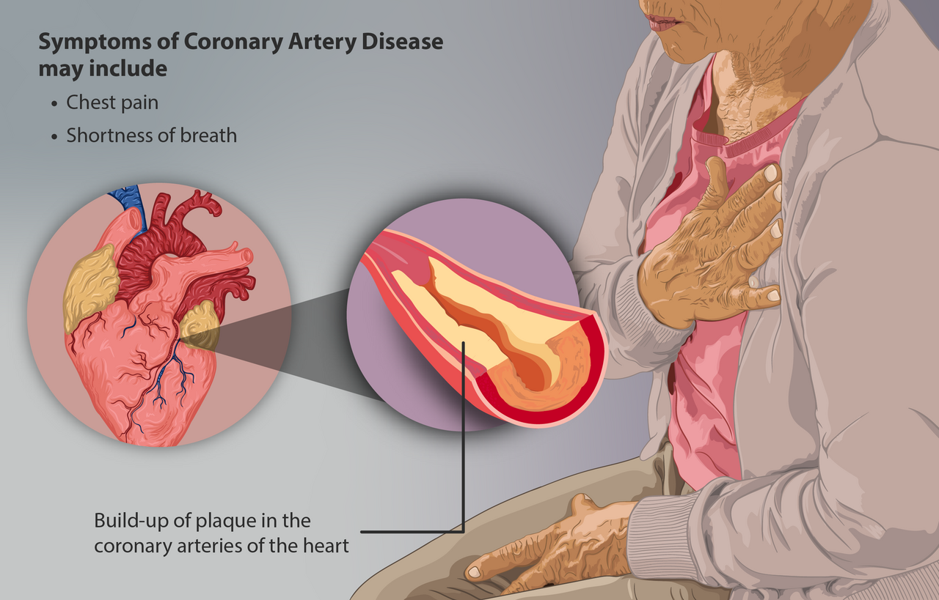
Cardiovascular Health Assessment and Risk Prediction
Goal : To predict weather patient has 10 year risk of Coronary Heart Disease(CHD)

Slide 2
Introduction
01
Why this project is and how machine learning can helps in achieving our goal.
Executive summary
02
Summary of the Project that is all explanation in one page.
EDA on important features
03
In this section we will analyse the dataset
ML Model Details
04
This section, we will know about ml model and its results
Conclusion
05
Recommendation about project

Slide 3
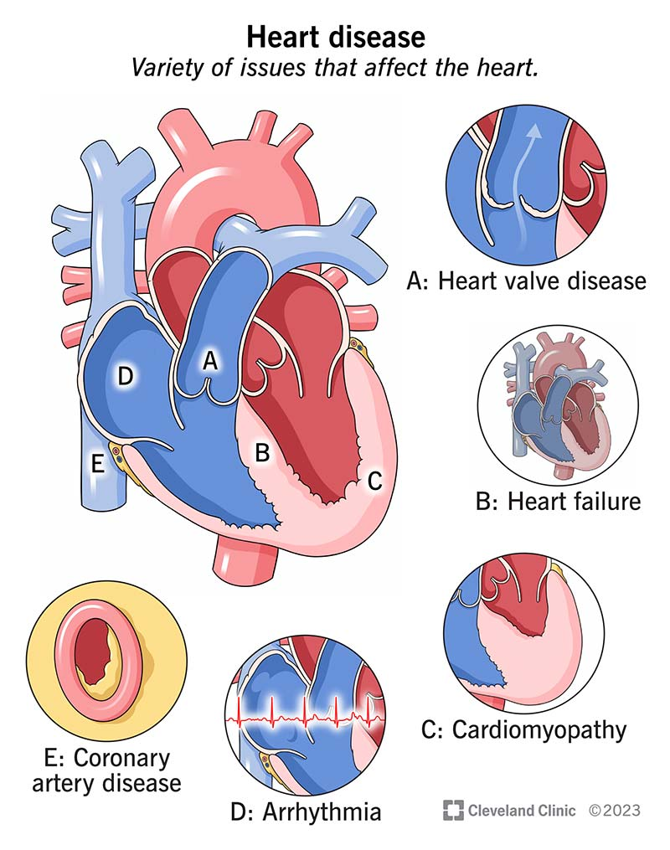
Introduction
Coronary Heart Disease (CHD) involves the reduction of blood flow to heart muscle due to build-up of plaque in the arteries of the heart.
The prediction of heart disease is considered one of the most important topics in health domain. With the machine learning algorithms and having large amounts of data, it is possible to use these information that can help doctors make more accurate predictions.
Prediction of CHD is a much complex challenge considering the level of expertise and knowledge required for accurate result. According to a survey by WHO, medical professionals can correctly predict heart disease with only 67% accuracy.
In this project, a number of independent variables such as sex, age, cigsPerDay, totChol, sysBP and glucose will be used along with a dependent variable (TenYearCHD class) during the training phase to build a classification model. The classification goal is to predict whether the patient has 10-year risk of future Coronary Heart Disease (CHD) or not.

Slide 4
Executive Summary
There are 16 independent variables and 1 dependent variable in the dataset. Feature id which does not have any contribution in modelling was dropped.
There are 7 features have missing values, out of these 7, 5 numerical features are imputed with median values of those features as there are outliers in all the 5 numerical features. 2 categorical features are imputed with mode of those features.
By doing feature engineering 2 new features Hypertension and Glucose_diabetes are created.
As dependent variable TenYearCHD is highly imbalanced, we use SMOTE for balancing training data.
Then applying several classifier models, we choose GradientBoostingClassifier as our optimum model as it provides best evaluation metrics for this dataset.

Slide 5
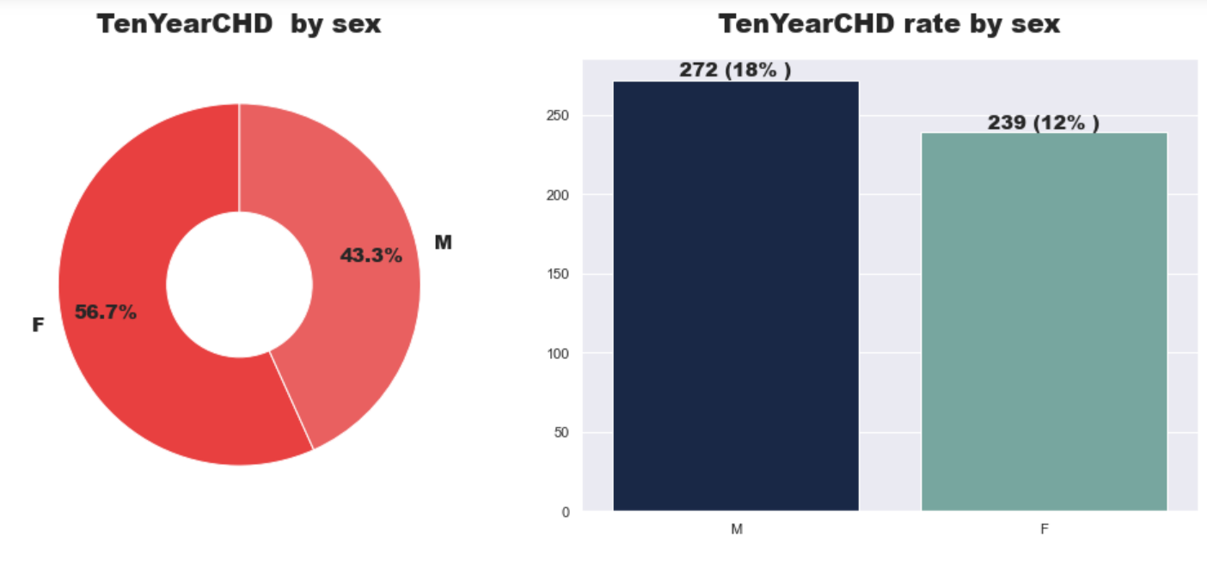
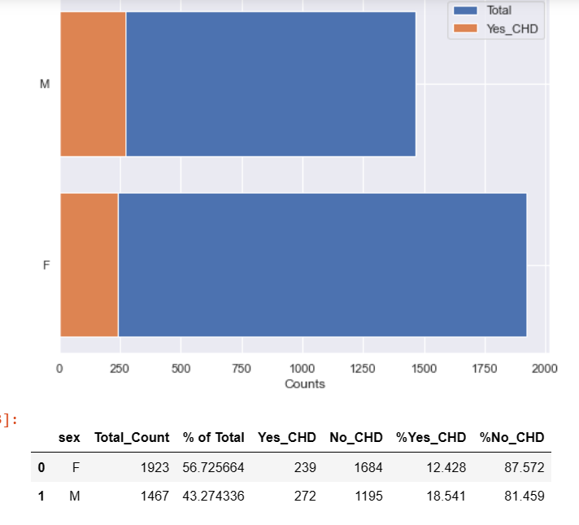
Which gender is more prone to CHD

Slide 6
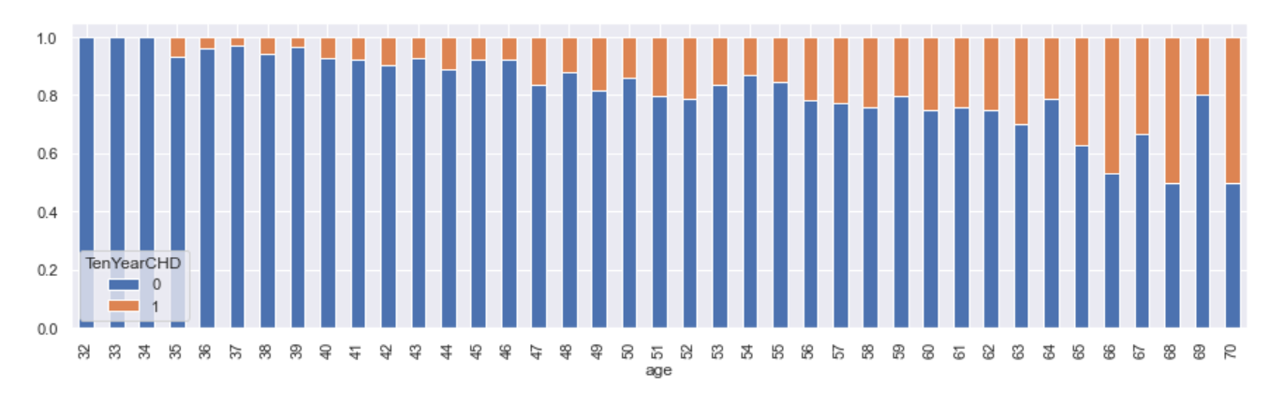
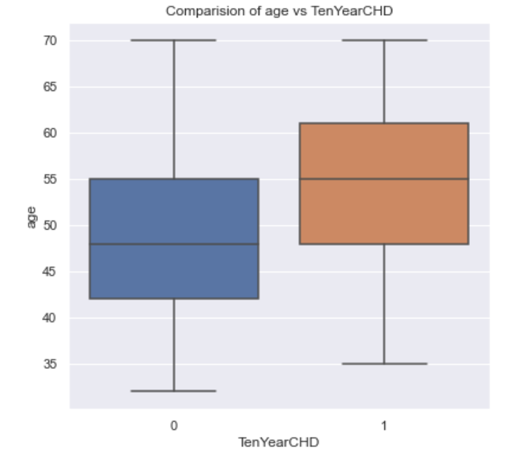
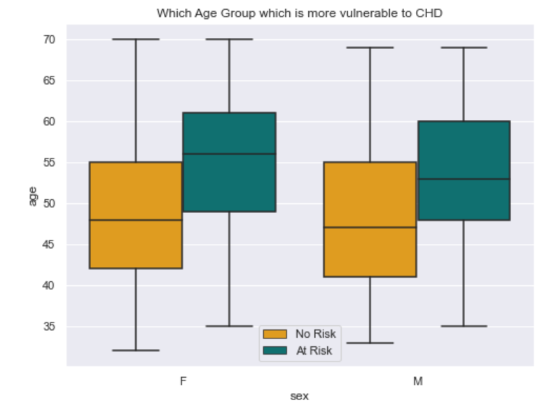
Analysis on age group vulnerable CHD

Slide 7
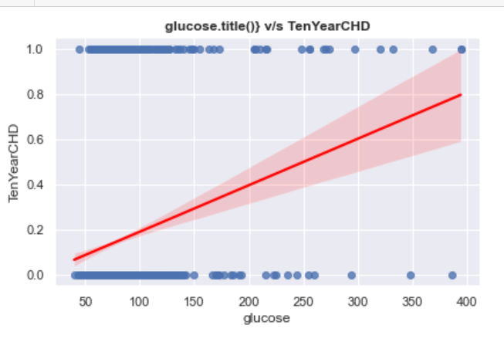
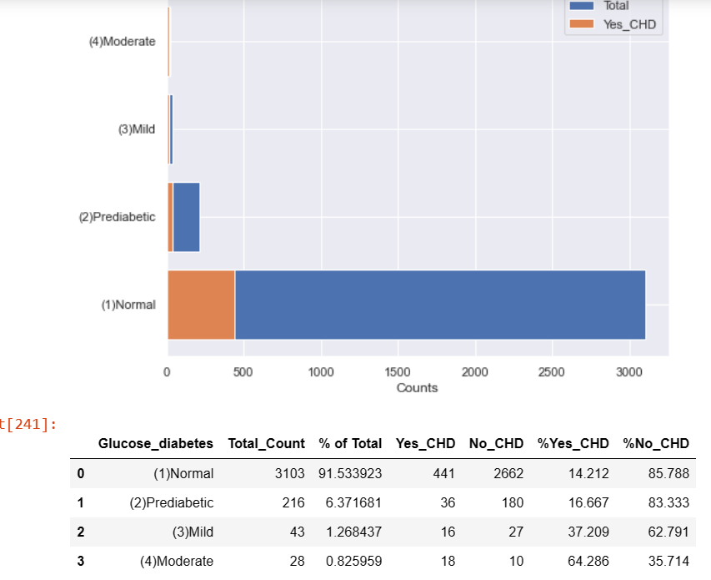
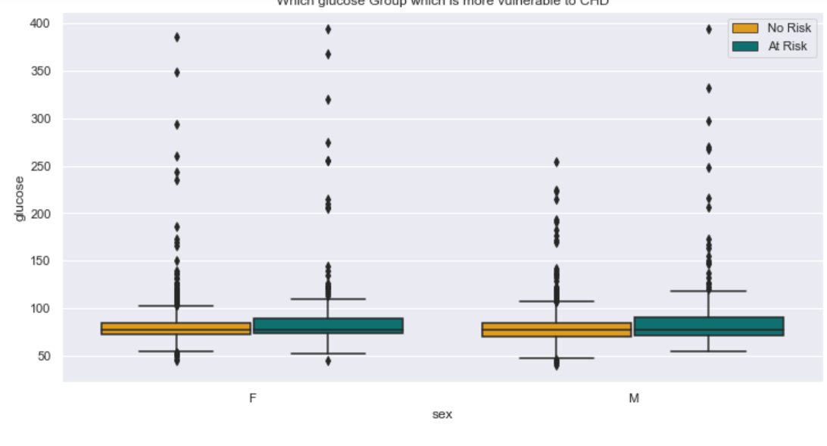
Effect of glucose on CHD

Slide 8
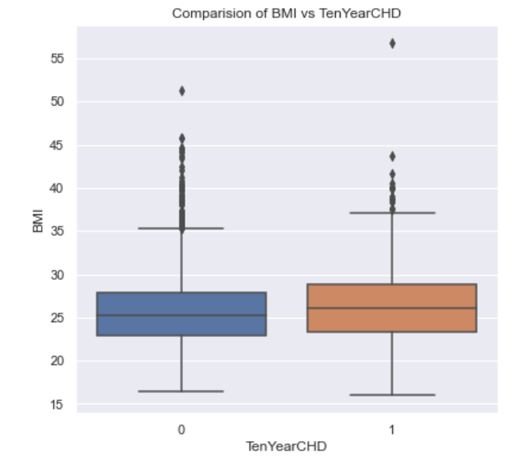
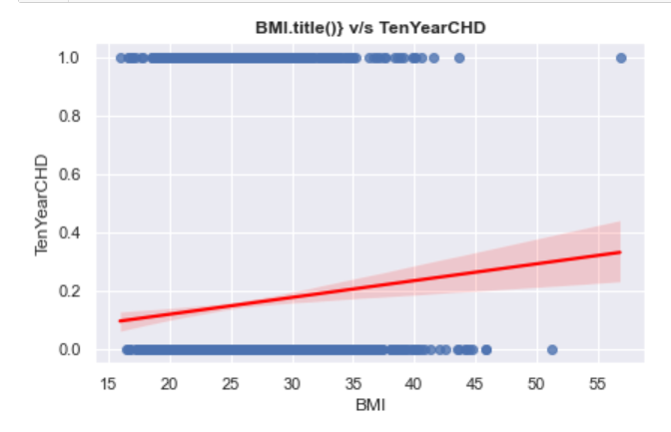
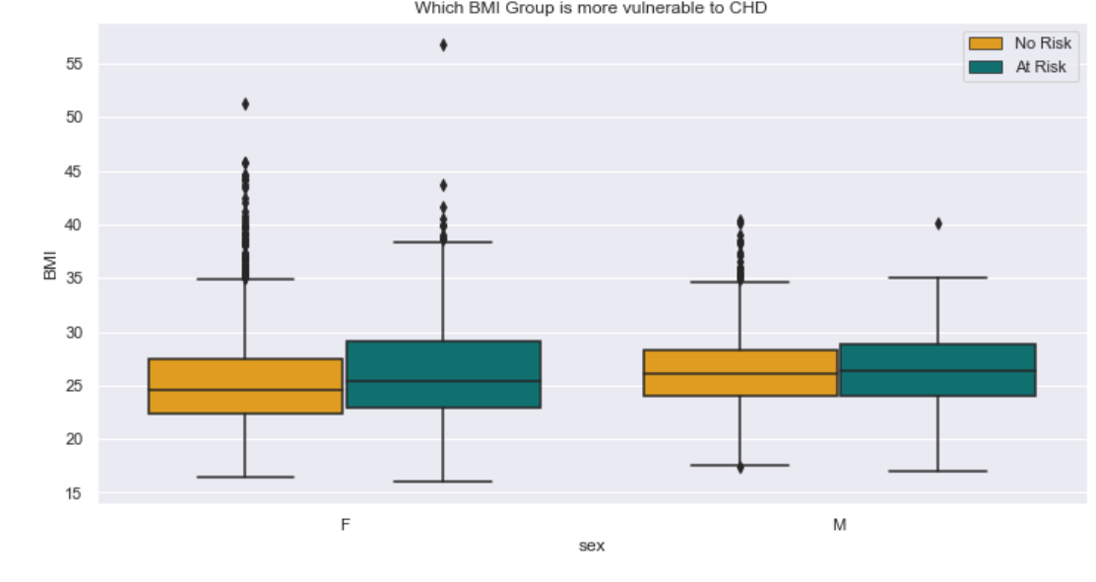
Analysis of BMI related to CHD

Slide 9
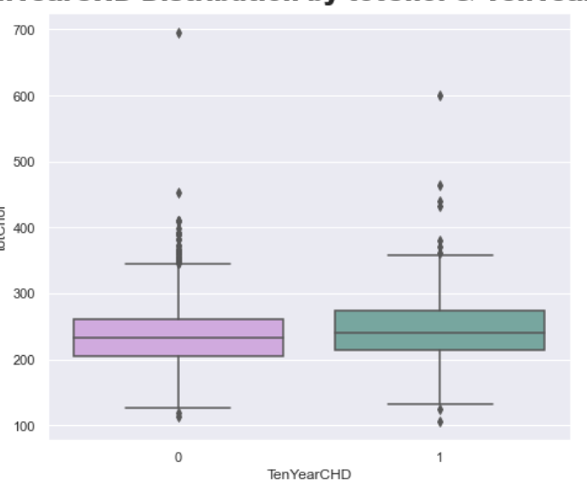
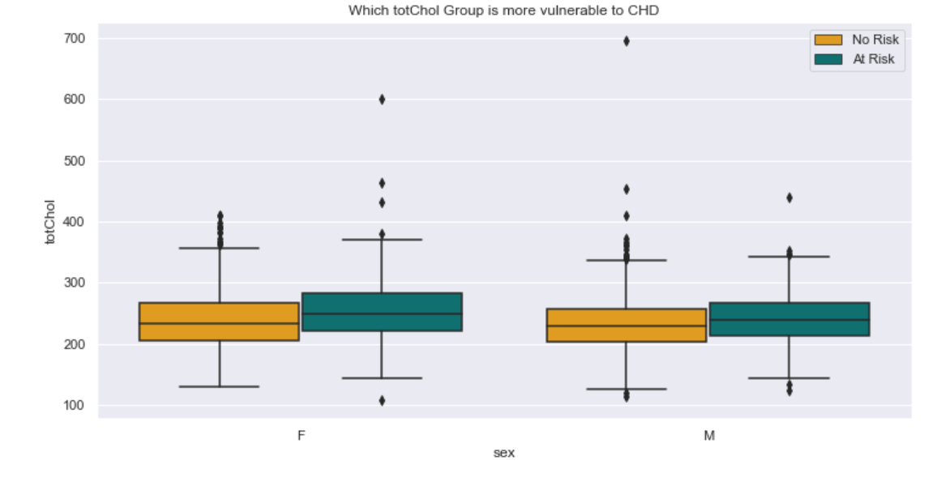
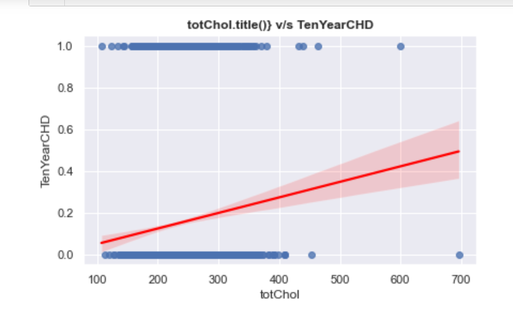
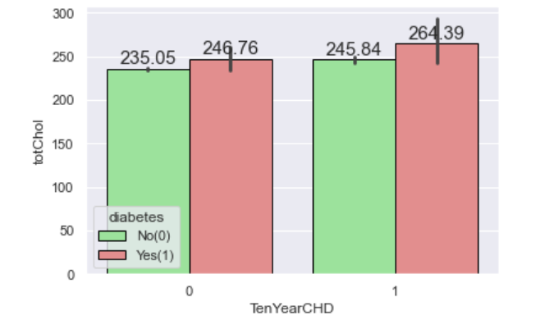
Analysis of totChol effect on CHD

Slide 10
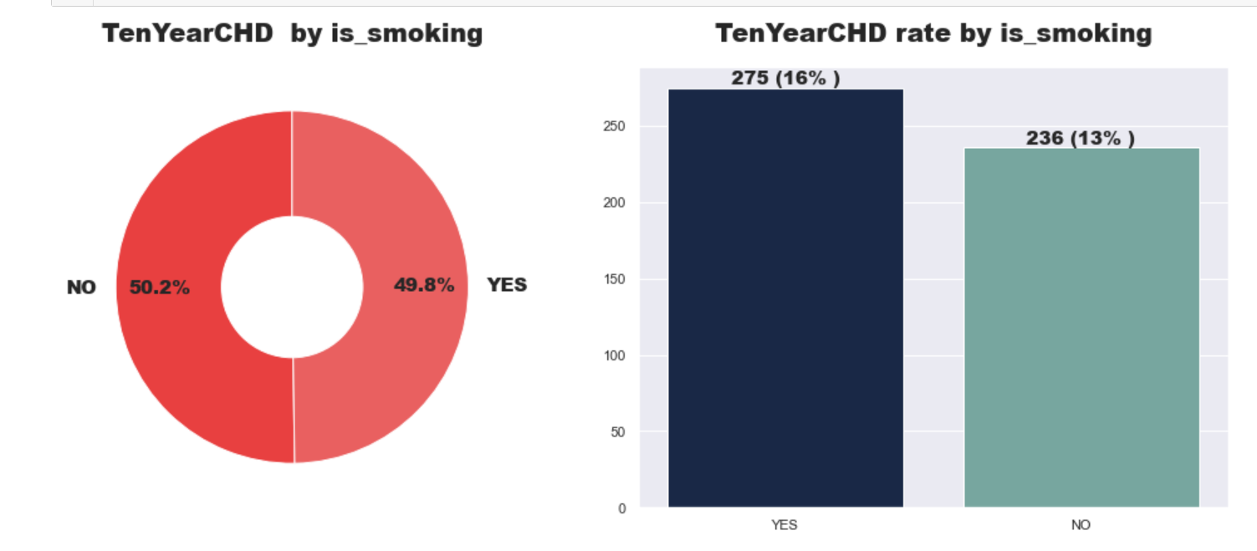
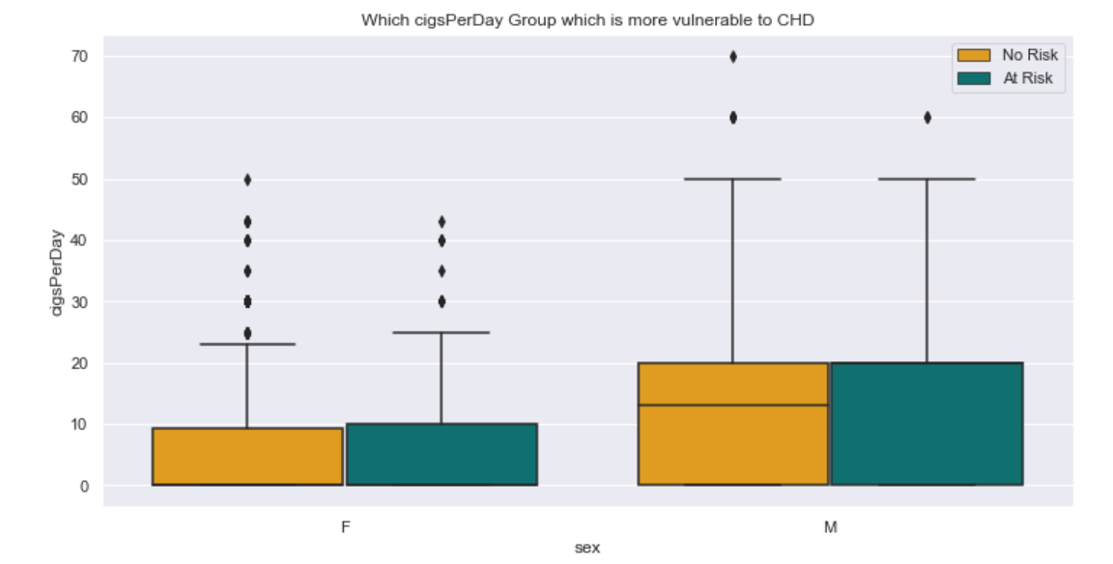
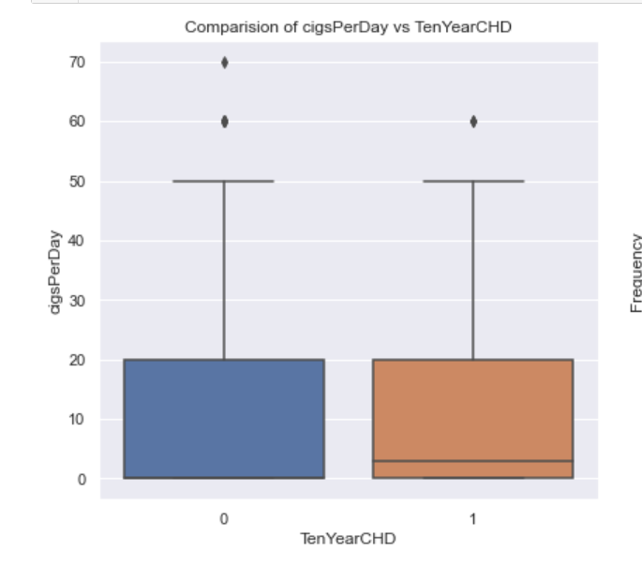
Effect of smoking related to risk of CHD

Slide 11
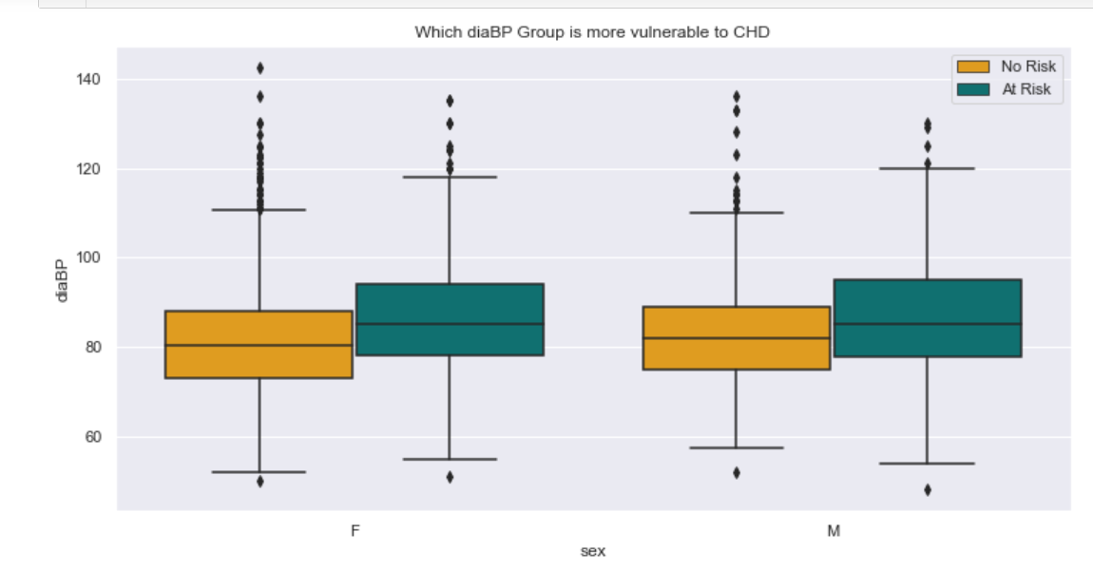
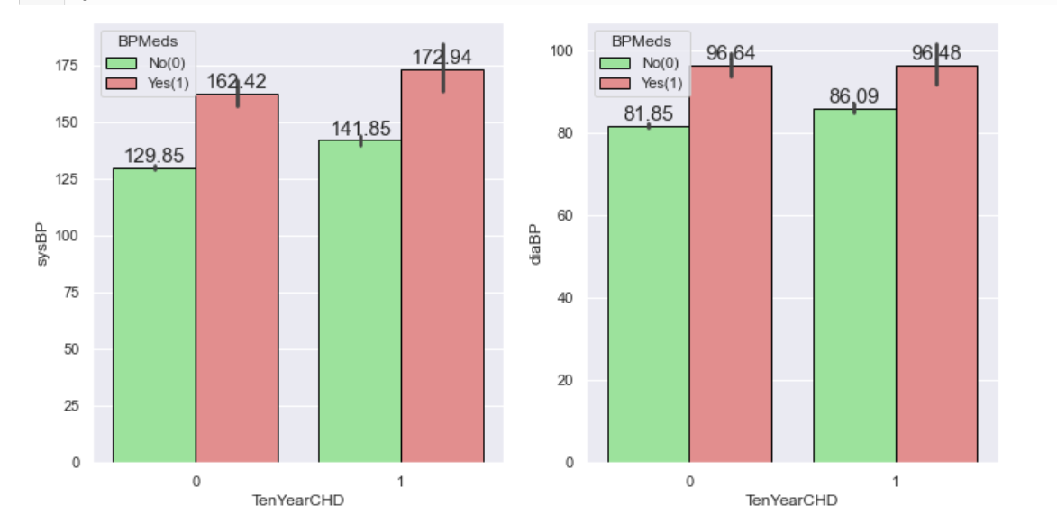
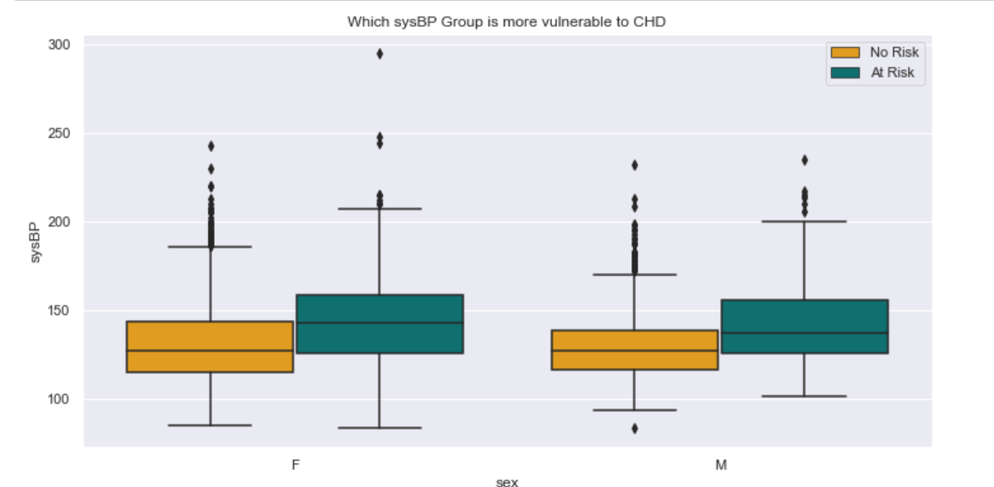
Systolic and diastolic bp effect on risk of CHD

Slide 12
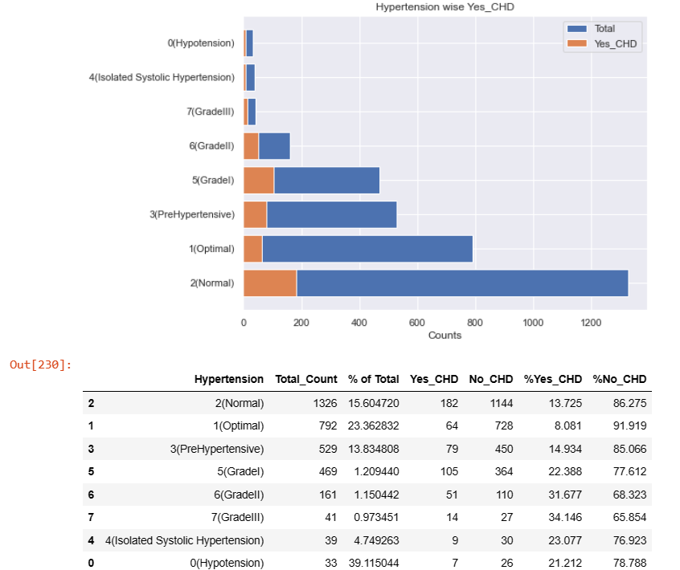
Effect of Hypertension on risk of getting CHD
Hypertension is combination of SysBP and DiaBP when,
(SysBP < 90) or (DiaBP < 60) = '0(Hypotension)’,
(SysBP < 120) and (DiaBP < 80) = '1(Optimal)’,
(SysBP < 129) or (DiaBP < 84) = '2(Normal)’,
(SysBP < 140) or (DiaBP < 89)=3 (PreHypertensive),
(SysBP > 140) and (DiaBP < 90)= '4(Isolated Systolic Hypertension)’,
(SysBP < 160) or (DiaBP < 100)='5(GradeI),
(SysBP < 180) or (DiaBP >=110):='6(GradeII)’
Others = '7(GradeIII)

Slide 13
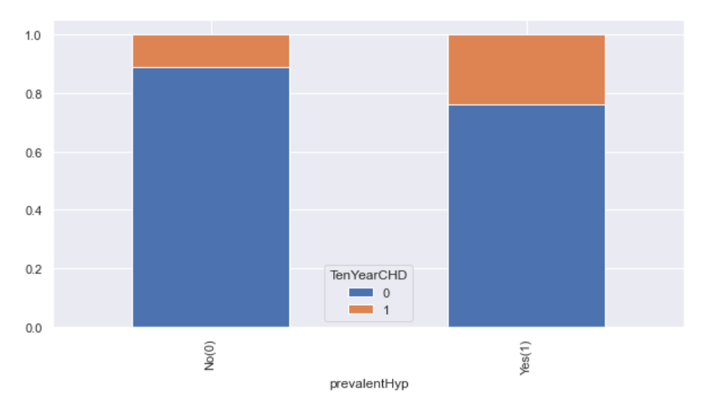
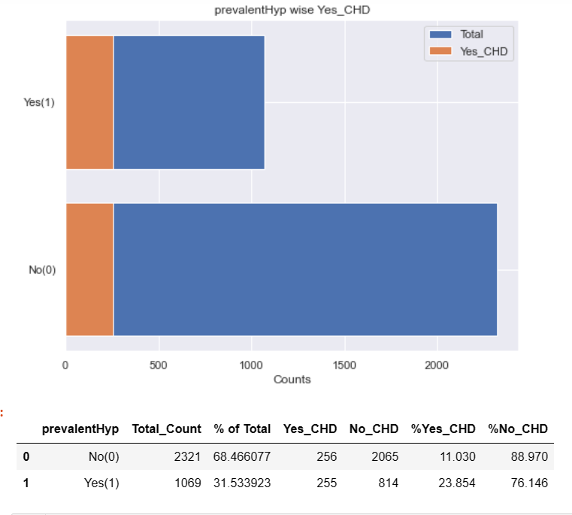
Effect of prevalentHyp on TenYearCHD

Slide 14
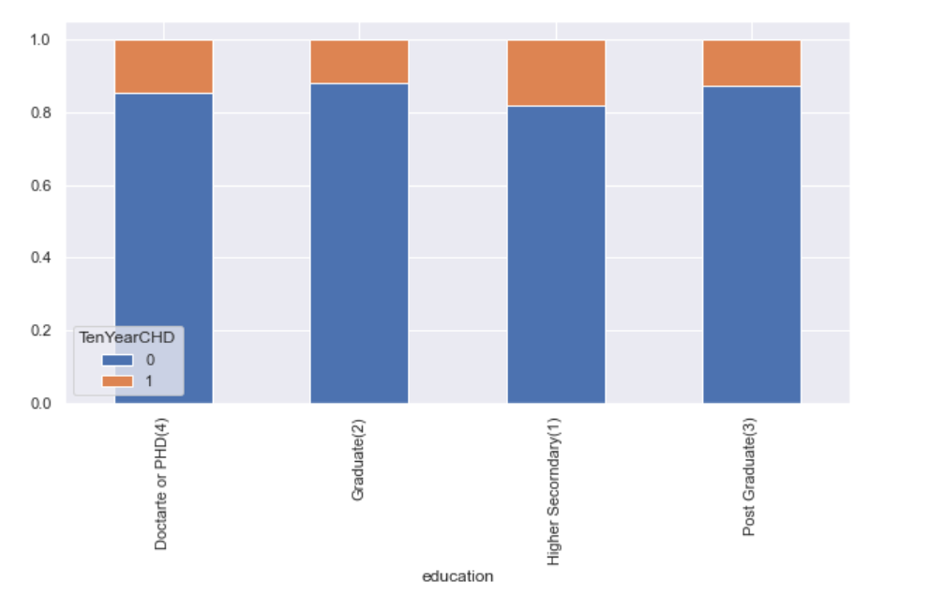
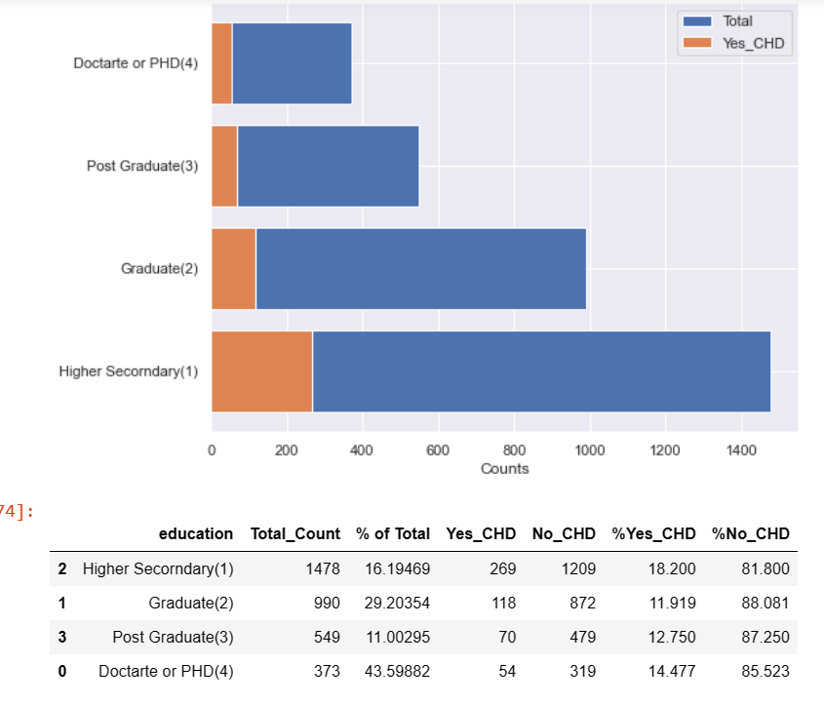
Education level wrt risk of CHD

Slide 15
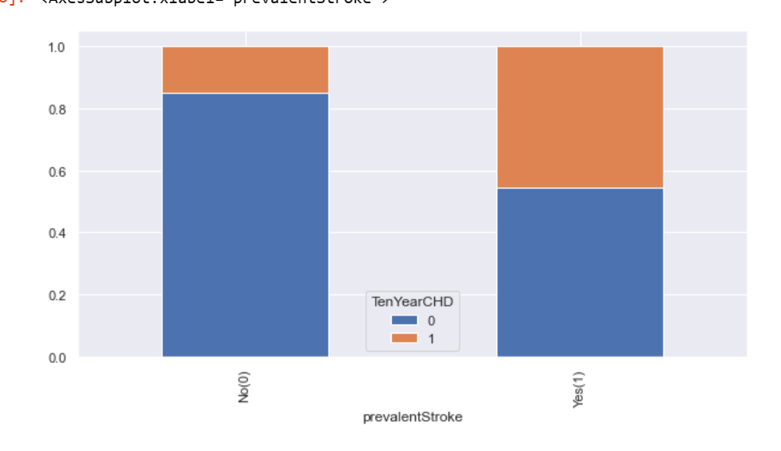
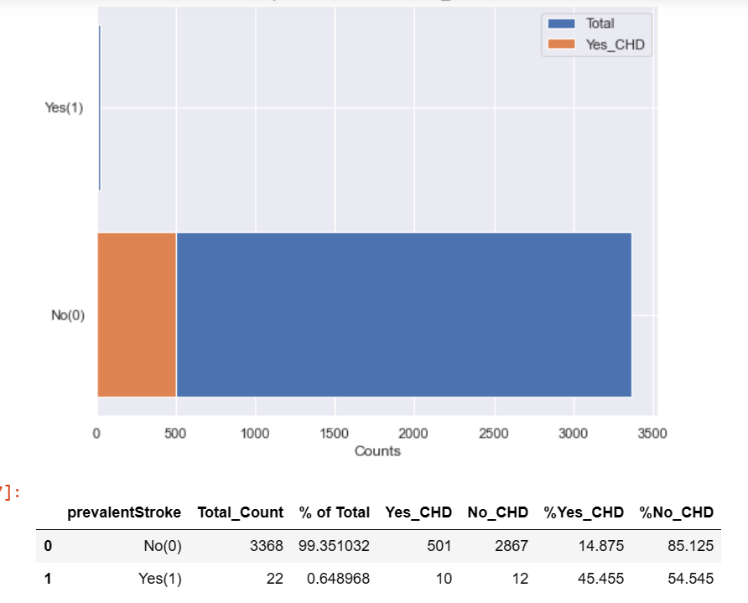
Effect of prevalentStroke on TenYearCHD

Slide 16
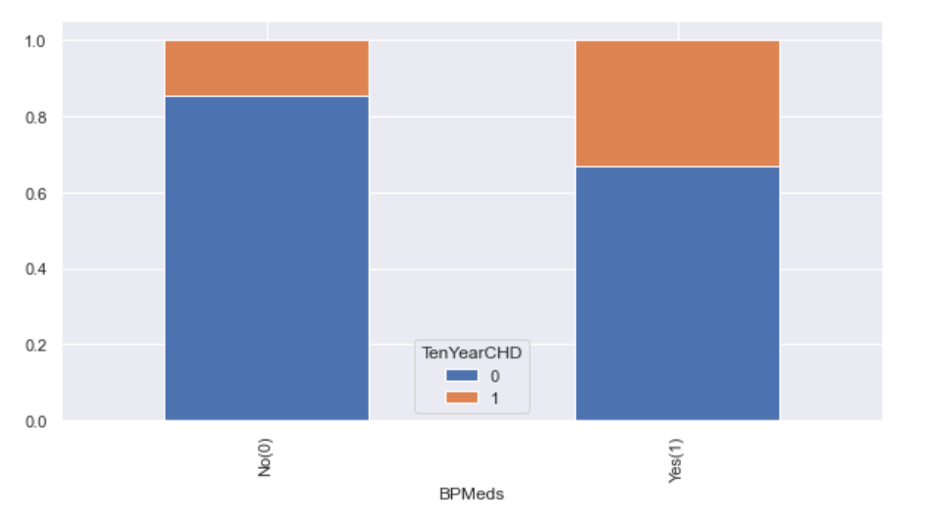
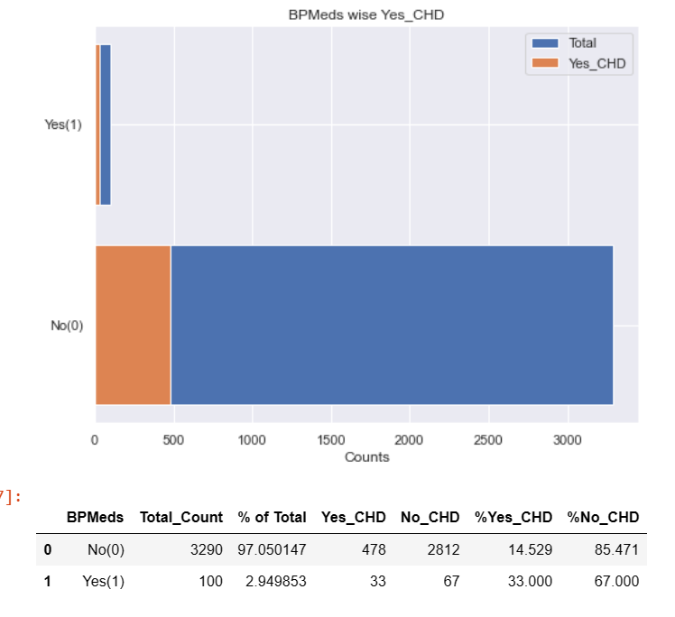
Effect of BPMeds on risk of getting TenYearCHD

Slide 17
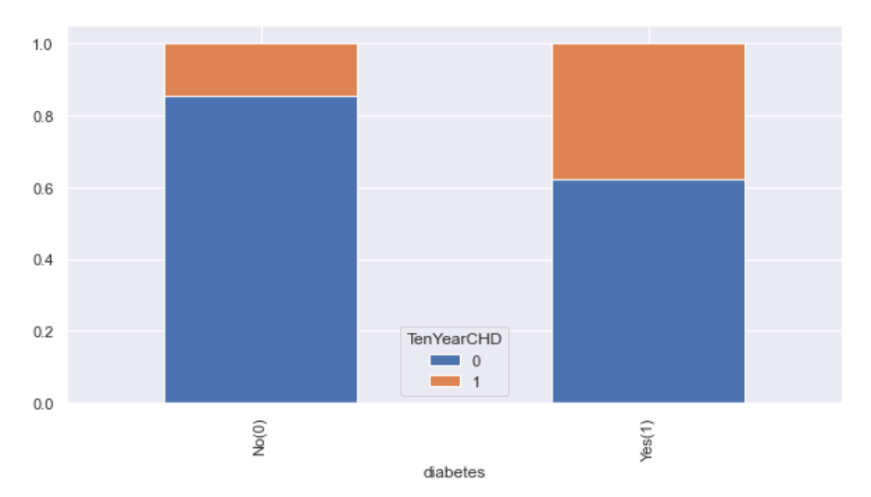
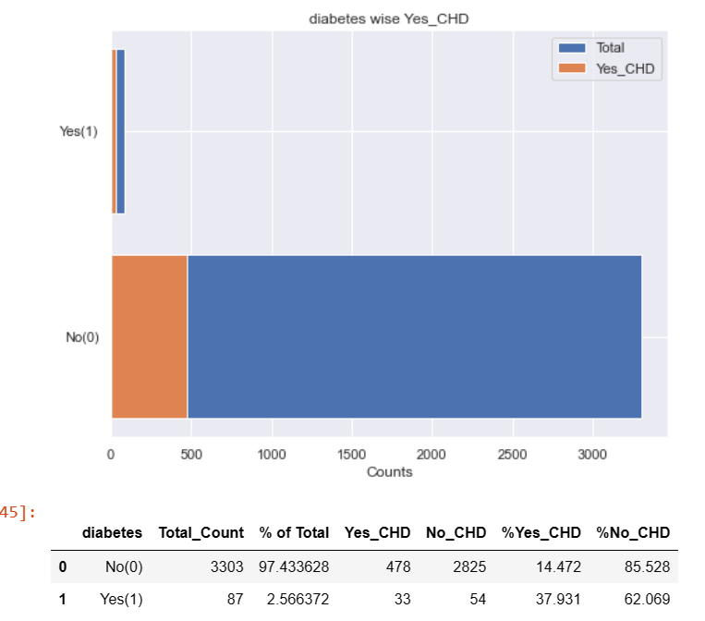
Effect of diabetes on risk of getting TenYearCHD

Slide 18
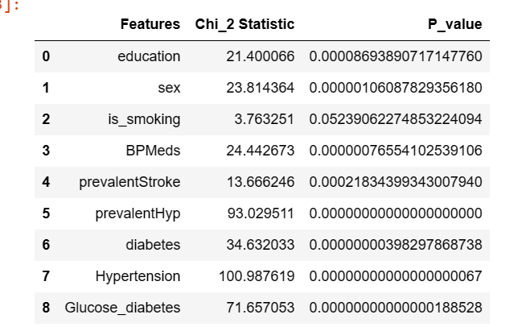
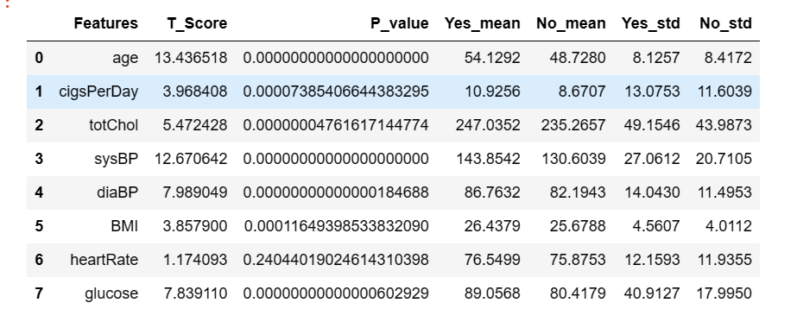
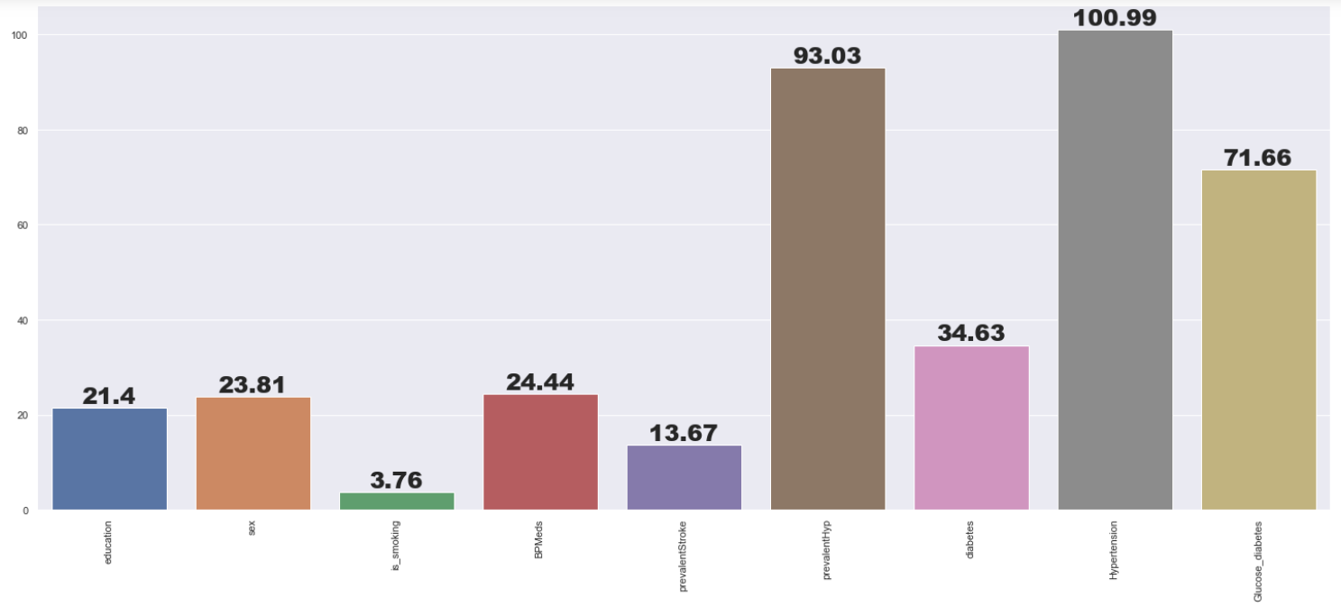
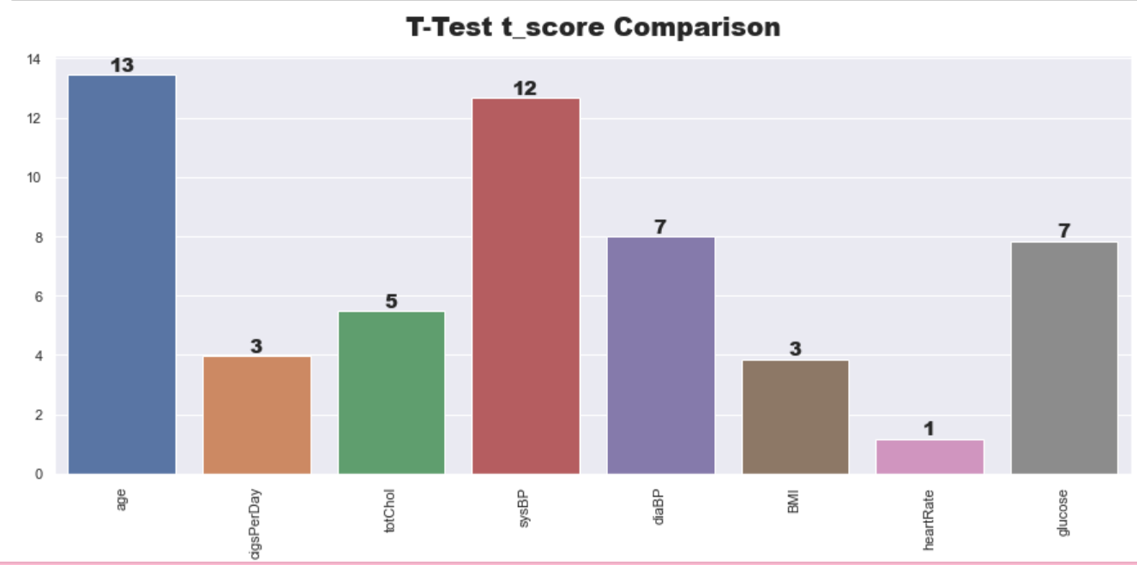
Hypothesis Test Result

Slide 19
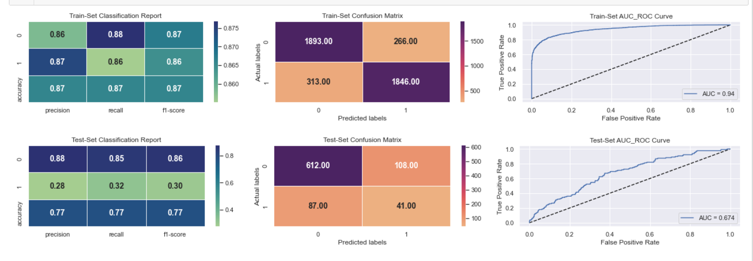
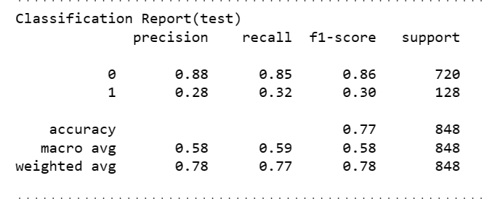
GradientBoostingClassifier Model Evaluation metrics

Slide 20
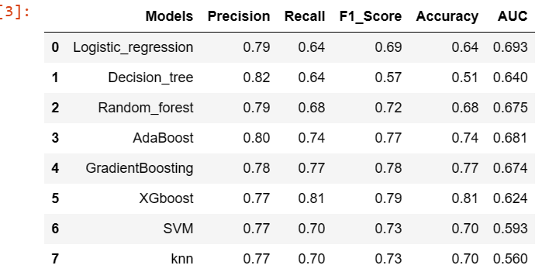
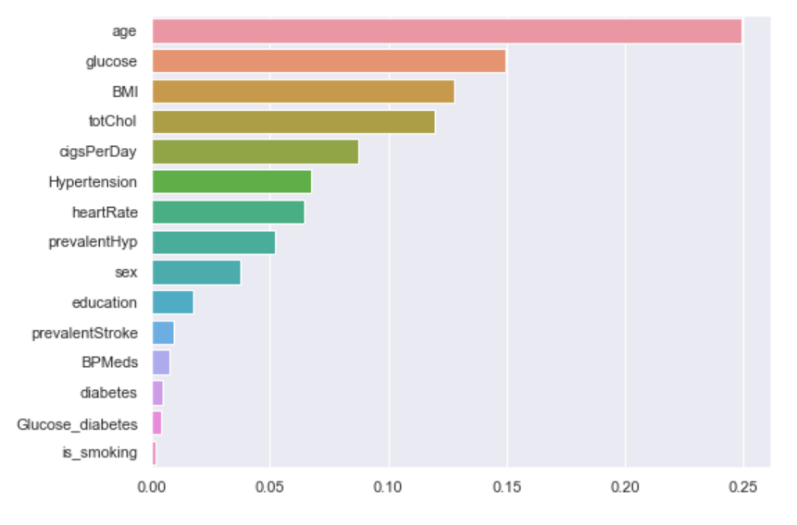
Feature Importance and all model results

Slide 21
Recommendation
As we saw earlier with increase in age risk of getting CHD in future increases and when compare with in genders, median age of risk of CHD is 55, but in case of males it is less than 55 i.e 53 and for women it is more than 55 i.e 56. So, all older people should be regular checked, particularly male as they have higher risk.
When it comes purely gender basis males are more prone to getting CHD than females, so, males of middle to old age people should regularly do medical check up.
With increase in glucose level, risk of CHD increases. When glucose level 200 to 400 risk of CHD is 64%, similarly for 120 to 200 is 37%, for 100 to 120 is 16 and for less than 100 is 14%.
With increase in BMI level risk of CHD increases, particularly among females as in males on median BMI level risk is there. So, for both genders controlling BMI is important, but in females it is important as their risk of getting CHD base level lower compare to males.
Similarly, with increase in totChol risk of getting CHD increases in both genders. Median totChol level for CHD in males and females are 240 and 248 respectively. Diabetic patients with high totChol level are more prone to getting CHD.
Smokers have high risk CHD, as males smoke more, there risk is higher compare to females.
People with GradeI(sysBP < 160 or diaBP <100), GradeII(sysBP<180 or diaBP>=100), GradeIII Hypertension and Hypotension(sysBP < 90 or diaBP < 60) are more prone to getting CHD in future. As we saw earlier people with prevalentHyp are more prone to CHD i.e 23.8% compared to 11.03%.

